Slide 1
Kuwait Integrated Petroleum Industries Company (KIPIC)
30 January 2023

Slide 2
Key Milestones To Date
October 2016
Establish legal entity of KIPIC
May 2017
KIPIC goes live
December 2017
Launch of Al-Zour Oil Complex
March 2021
Updating KIPIC’s 2040 Strategy Plan
April 2022
Commissioning of LNG Terminal
November 2022
Commissioning of 1st mini refinery

Slide 3
KIPIC Mandate, Vision, Mission, and Organizational Philosophy are driven by KPC Strategic Directions
Mandate
“Manage refinery, petrochemical and LNG import operations in the Al-Zour Complex”
Vision
“To be a leader in integrated refining and petrochemical operations and LNG supply that maximizes shareholder value, achieves operational excellence, unlocks the potential of our people and cares for the community”
Mission
“To manufacture refined petroleum and petrochemical products and supply LNG in a reliable, efficient, safe and environmentally responsible manner to meet Kuwait’s energy demand, maximize profit through integration, develop a professional and competent workforce, and enable the development of the local economy”
Organizational Philosophy
“Making more possible”
Net Zero
Maximize production and achieve net zero scope 1+2 GHG emissions by 2050

Slide 4
KIPIC is Responsible for Integrated Refining, LNG Import And Petrochemicals Activities in Al-Zour Complex
KIPIC
(Kuwait Integrated Petroleum Industries Company)
Al-Zour Complex
Al-Zour Refinery Facility
LNG Import Facility
PRIZe (First Upgrade)
ZICUP (Second Upgrade)
Products
High Value Products
& Fuel Oil
Natural Gas
Gasoline, Aromatics and Olefins
High Value Products
Project Value
KD 4.87 bn
KD 1.1 bn
KD 3.0 bn
KD 2.9 bn
Capital Structure
100% Equity
(SACE financing for Package 4 through KPC)
70% Debt (Korean ECA’s, Local Banks)
30% Equity
70% Debt (Seeking)
30% Equity
NA
Current Status
Commissioning
Operational
Final Investment Decision
Feasibility Study
Expected Completion
March 2023
Completed in April 2022
2029
2032
Capacity
615,000 barrels per day
3,000 BBTU per day
1.7 MMTA Mogas
1.4 MMTA PX
0.94 MMTA PP
NA
KD 6 Billion investment for planned Petrochemical Projects during 2024 – 2032.

Slide 5
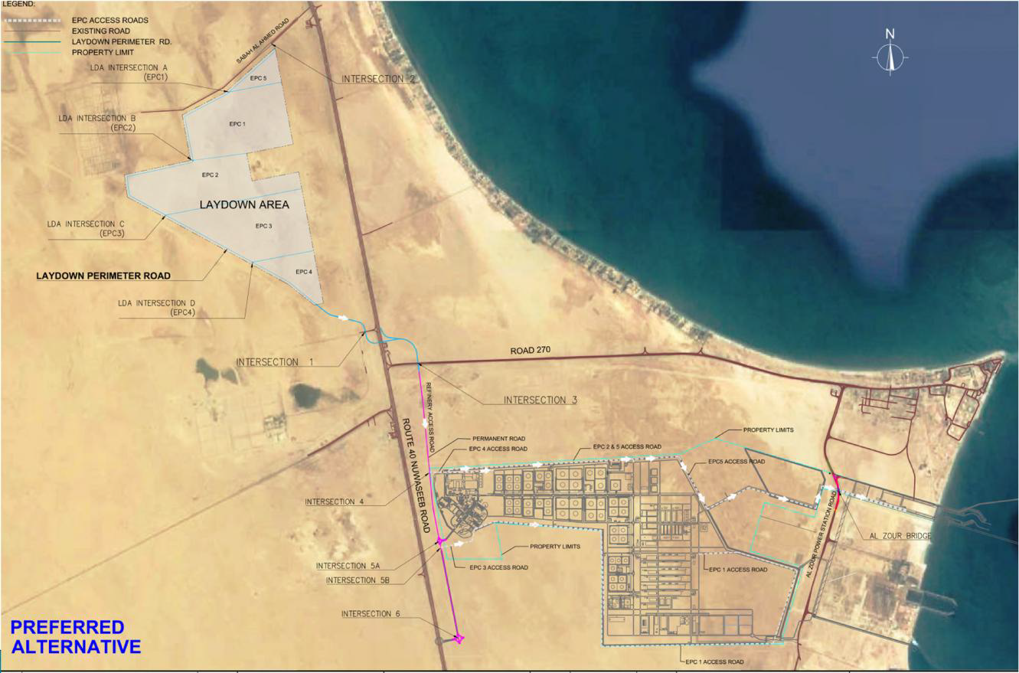
ZOR Satellite Image
Highway 40
Road 270
Mina Al Zour
Wafra
Highway
Chevron
ZOR
Access Road
Al Zour
Power Plant
Al Khiran
Pearl City
ZOR Site

Slide 6
Al- Zour by 2029
NAPHTHA
JET A1
FUEL GAS
NAPHTHA HDT
HDT
KERO
SAT GAS PLANT
LPG
DIESEL
SULFUR
HDT
DIESEL
SULFUR UNIT
NAPHTHA
CDU
CRUDE
(KEC+MIX CRUDE)
ARDS
LIGHT NAPHTHA
ISOM
REF
ATM RESIDUE
HDT
CCR
BENZENE
AROM COMPLEX
P-XYLENE
NATURAL GAS
REFORMATE
ARDS RESIDUE
AROMATICS BLOCK
RFCC
PP
ERU
PRU
PP
IMPORTED LNG
MOGAS
GASOLINE BLOCK
ISOM
MTBE
OLEFINS BLOCK
LNG TO END USERS (MEW, ZOR, KOC NETWORK)
AUX UNITS
VLSFO/LSFO
TO MEW / EXPORT & FUTURE UPGRADE

Slide 7
Criteria to Qualify Contactors for Mega Projects
Contractors Experience:
This is a key factor, as for mega projects you would want an international experience contractor that have successfully executed a mega project with similar scope.
Establishment:
Personal/Manpower breakdown for engineering, procurement and construction showing their company’s own resources/direct employees and workloads.
HSSE:
This is an important part of any project, contractor must demonstrate his policies, procedures and HSSE performance.
Quality Assurance:
Contractor must demonstrate his quality management systems and appropriate/valid certificates.
Finance:
Contractors balance sheets of his recent years are required to reflect his capability on taking on the project smoothly.

Slide 8
Thank You

Slide 9
Contact Details
Sr. | Name | Designation | Tel. | Email
1 | Abdullah Fahad Al-Osaimi | Manager, Corporate Planning | 23898001 | a.osaimi@kipic.com.kw
2 | Wafaa Bader Al-Othman | Team Leader, Strategic Planning | 23898050 | w.othman@kipic.com.kw
3 | Saad Alkharji | Senior Eng. Strategic Planning | 23898058 | s.alkharji@kipic.com.kw

